Slide 1
Professional Skills for data science
Data frames and tidy data Ed Harris, Joseph Mhango

Slide 2
Objectives
Common data file types
Excel, data setup, and the Data Dictionary
Getting data into R
Manipulating variables in the Data Frame
Practice exercises

Slide 3
Tidy data concept
Archives data in accessible format
Data “transparent” to others
“Tidy Data” credit: Hadley Wickham (lead statistician at Posit)
Wickham 2014

Slide 4
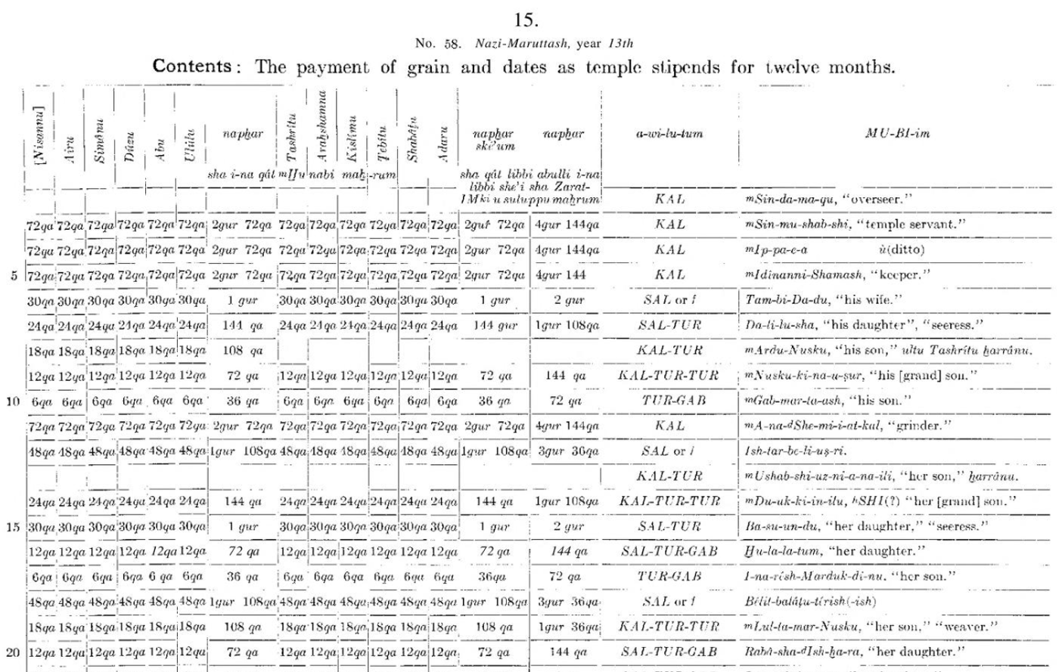
Tidy data concept

Slide 5
Common data file types
(c)sv comma separated values + others
Excel
Avoid (!) proprietary formats
Data Dictionary

Slide 6
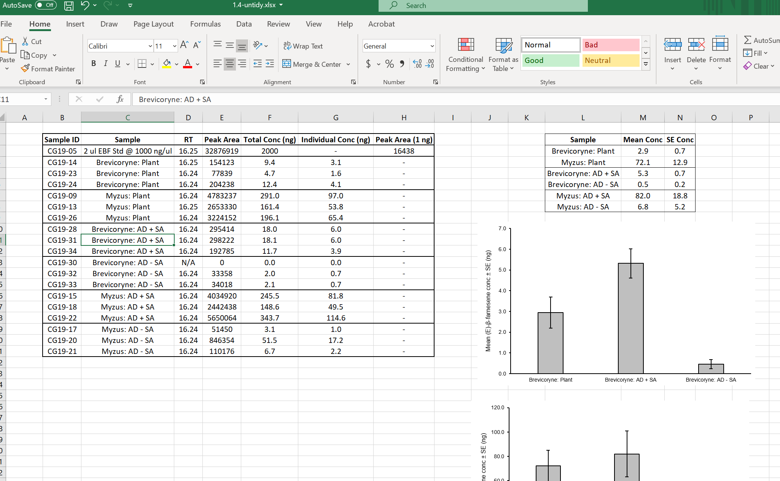
Untidy data

Slide 7
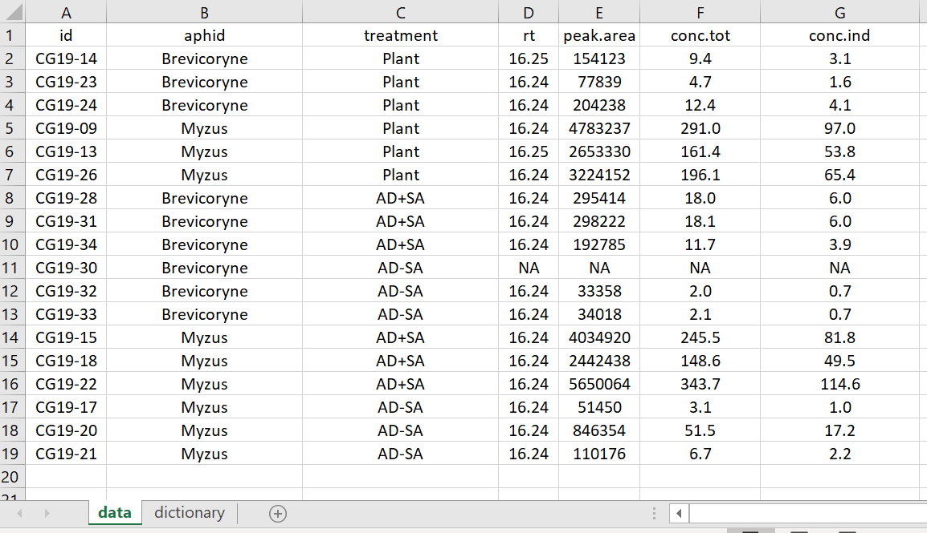
Tidy data

Slide 8
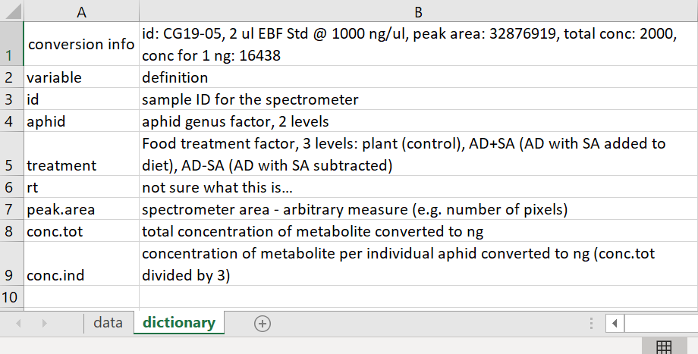
Tidy dictionary

Slide 9
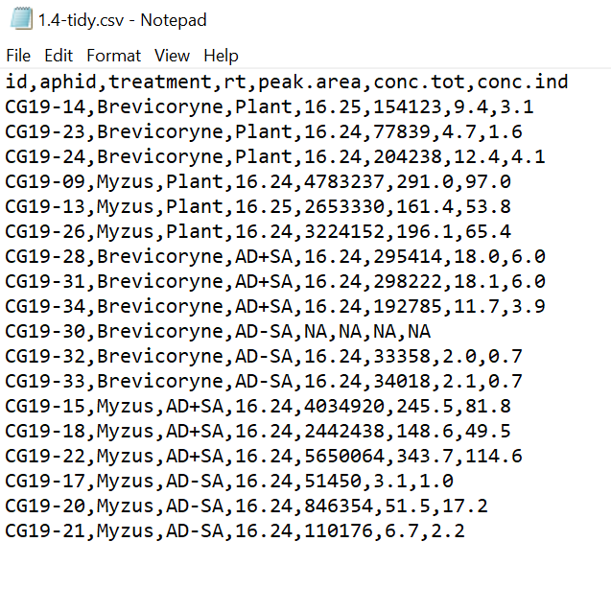
Tidy csv

Slide 10
Getting data into R
Choices
from File > Import Data
readxl::read_excel()
openxlsx::read.xlsx()
Demonstration

Slide 11
Manipulating variables in the Data Frame
class()
names()
str()
indexes [ , ]
attach()

Slide 12

Practice Exercises

